Slide 1
PhD Course: Advanced Energy Systems Analysis on the EnergyPLAN Model Danish Case: Transport Sector
Hamza Abid

Slide 2

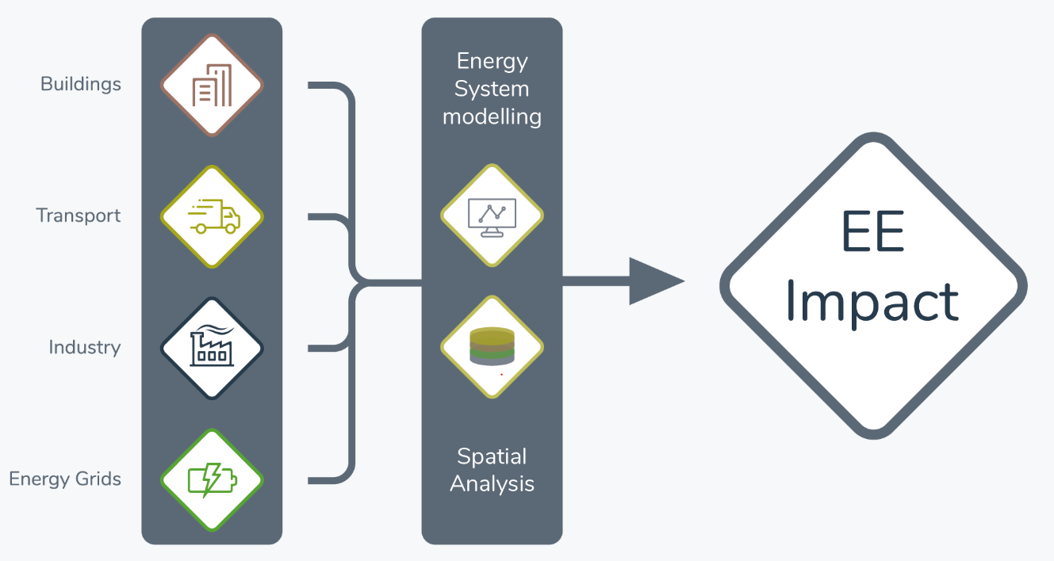
Introduction
“Quantification of synergies between energy efficiency first principle and renewable energy systems for 2050 decarbonization”

Slide 3

Introduction
Reference Year: 2020
DEA Energy and Climate Outlook 2018
Existing Scenarios
IDA Energy Vision 2050
DEA Wind 2050
DEA Fossil 2050

Slide 4
Denmark 2050 Scenarios
Source: IDA Energy Vision, Technical Data and Methods Report 2015

Slide 5
Denmark Energy and Climate Outlook 2018
Source: DEA Climate Outlook 2018

Slide 6
Denmark IDA Energy Vision 2050
Source: IDA Energy Vision, Technical Data and Methods Report 2015

Slide 7
Denmark DEA Wind 2050
Source: IDA Energy Vision, Technical Data and Methods Report 2015

Slide 8
Denmark DEA Fossil 2050
Source: IDA Energy Vision, Technical Data and Methods Report 2015
Notes:
No biofuels or electrofuels

Slide 9
IDA 2050: Transport Electrification

Slide 10
IDA 2050: Transport Electrification Results
 | Transport Fuel Demand (TWh/year) | CEEP Avg (MW) | CO2 (Mt)
IDA 2050 (Electrofuels) | 36.12 | 412 | -7.6
IDA 2050 (Direct Electrification) | 10.12 | 143 | -2.63

Slide 11
DEA Wind 2050: Transport Electrification
Source: IDA Energy Vision, Technical Data and Methods Report 2015
Notes:
Gas busses and trucks are included in both fossil and wind scenarios,
as an input from the gas grid

Slide 12
DEA Wind 2050: Transport Electrification Results
 | Transport Fuel Demand (TWh/year) | CEEP Avg (MW) | CO2 (Mt)
Wind 2050 (Electro fuels) | 39.08 | 1862 | -5.72
Wind 2050 (Direct Electrification) | 10.46 | 1111 | -5.25

Slide 13
DEA Fossil 2050: Transport Electrification
Source: IDA Energy Vision, Technical Data and Methods Report 2015

Slide 14
DEA Fossil 2050: Transport Electrification Results
 | CEEP Avg (MW) | Transport Fuel Demand (TWh/year) | CO2 (Mt)
DEA Fossil 2050 | 788 | 39.6 | 23.27
DEA Fossil 2050 (Electrification) | 89 | 10.46 | 28.61

Slide 15
Impact of Covid-19 on Danish Transport Emissions: 2020

Slide 16
2020: Impact of Covid-19 on Transport Emissions
 | CO2 emissions Net (Mt) | Total Annual Costs (Million Euro) | Transport Fuel Demand (TWh/year)
Reference | 32.06 | 18815 | 60.5
Aviation + Road | 23.9 | 17044 | 28.27
Aviation | 29.42 | 18479 | 52.35
Reduction - Aviation + Road | 25% | 9% | 53%
Reduction - Aviation | 8% | 2% | 13%

Slide 17
Thank You ☺

